Slide 1
December NATIONAL COCOA Day
Yogurt
Chocolate Dipped Strawberry Smoothie
Island Joy Smoothie
YoCocoa Dip
Speed Scratch
Cocoa Banana Whole Grain Muffins
IW Section
Cocoa Puffs –add marshmallows
Chocolate Dipped Strawberry Smoothie | General Mills Convenience and Foodservice (generalmillscf.com)
Island Joy Smoothie | General Mills Convenience and Foodservice (generalmillscf.com)
Yo-Cocoa Dip | General Mills Convenience and Foodservice (generalmillscf.com)
Cocoa Banana Whole Grain-Rich Muffin Squares | General Mills Convenience and Foodservice (generalmillscf.com)
https://www.generalmillscf.com/recipes/cocoa-banana-muffins/9368b5ba-083a-41a6-9282-febacd10f5c5/

Slide 2
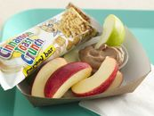
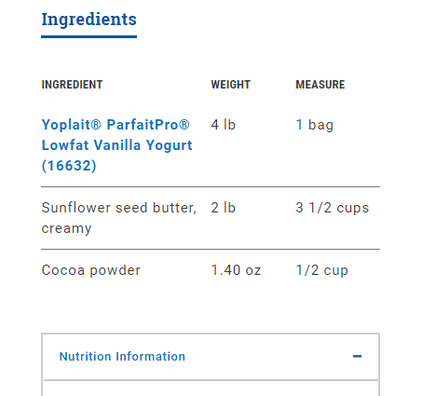
Yo-Cocoa Dip | General Mills Convenience and Foodservice (generalmillscf.com)

Slide 3
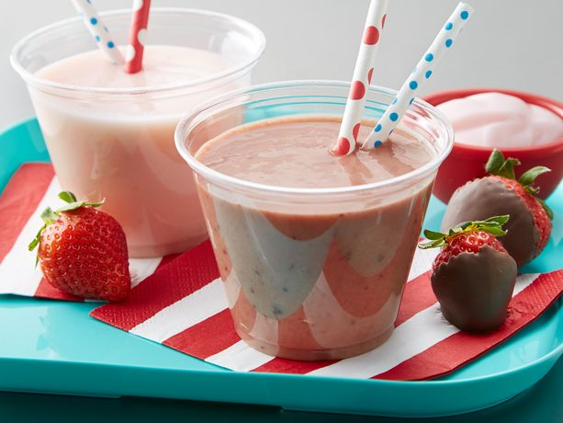
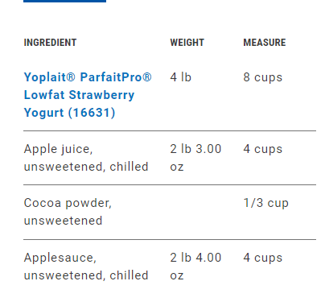
Chocolate Dipped Strawberry Smoothie | General Mills Convenience and Foodservice (generalmillscf.com)

Slide 4
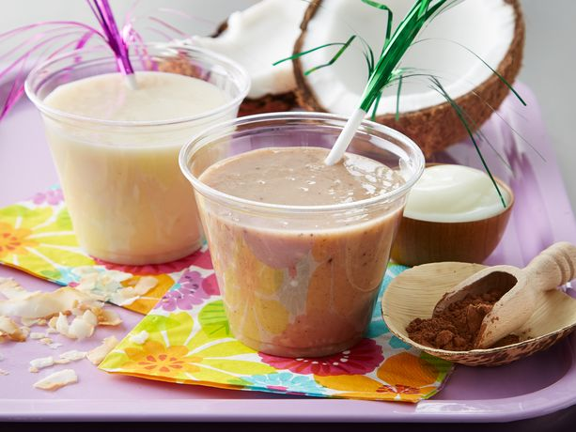
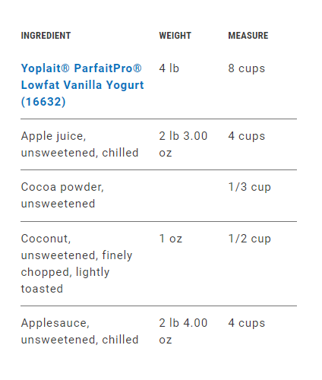
Island Joy Smoothie | General Mills Convenience and Foodservice (generalmillscf.com)

Slide 5
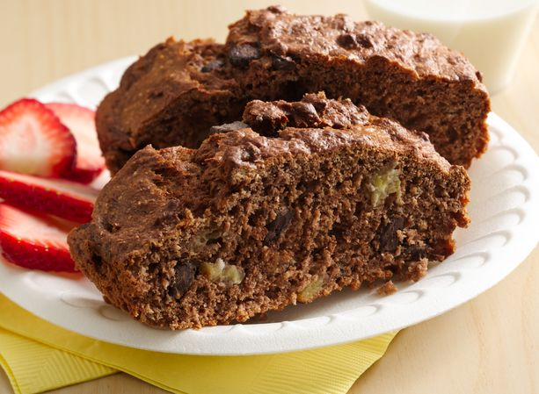
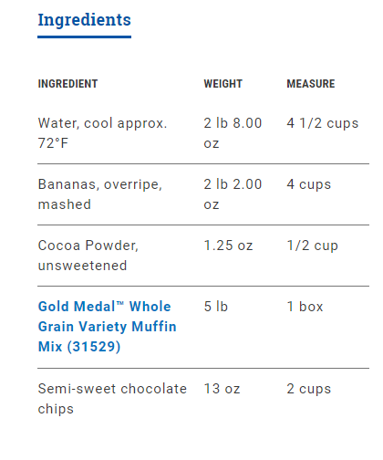
Cocoa Banana Whole Grain-Rich Muffin Squares | General Mills Convenience and Foodservice (generalmillscf.com)
Do a ½ batch
2 cups bananas
¼ cup cocoa powder
1 cup chips

Slide 6
